Slide 1

AirBnb - What story does your data tell?
Team 07 - Miami
Arjun Bajpai, Pooja Datre, Purvi Kakkasagar, Sushil Kogta, Palash Pandya, Mihir Wachasundar

Slide 2
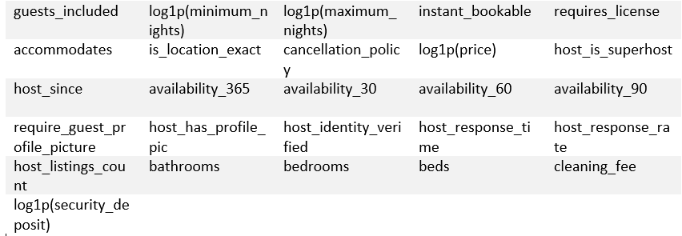
Kaggle Competition
Replaced logical and factor variable levels with numeric values and then imputed NAs with medians; created new dummy variables for categorical variables with numeric values for building models.
Linear model
RMSE: 0.361.
Kaggle AUC: 0.876.
Notes:
+amenities and other dummies as individual columns
Adjusted R-squared: 0.3517

Slide 3

Miami Challenge
After NY, highest number of tourists.
Tropical weather, Beaches, Year-Round activities, Conventions.
High-Demand and High-Occupancy.
But our major research questions?
What is the importance of different amenities in regards to high booking rate ?
Which room type is more attractive?
Which property type is more suitable for investment ?
What are important things to make host a super host?
Building a Dream Rental in Miami for Investors and Visitors
Notes:
How to design the rental with the preferred amenities changed to 1st question

Slide 4

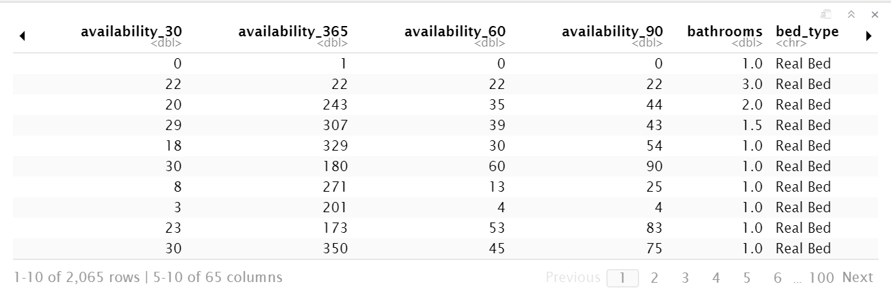
Data Description, Cleaning and Preprocessing
In total we had 66 variables.
Training dataset: 6195 rows.
Test dataset: 2065.
Type Conversion.
Performed log transformation for right-skewed variables.
Treated missing data.
Created dummy variables for categorical variables.
Sample Data

Slide 5
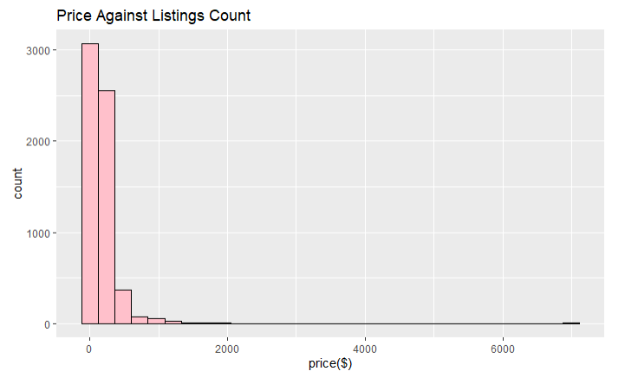
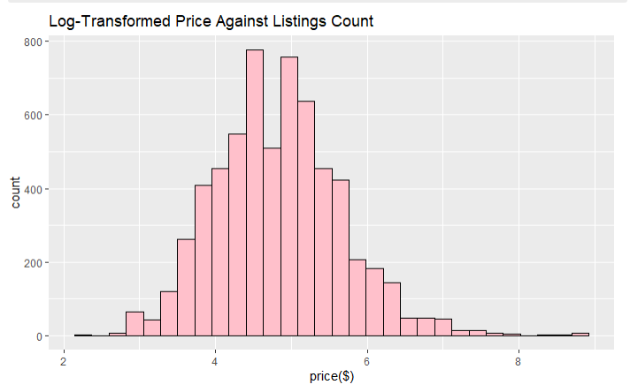
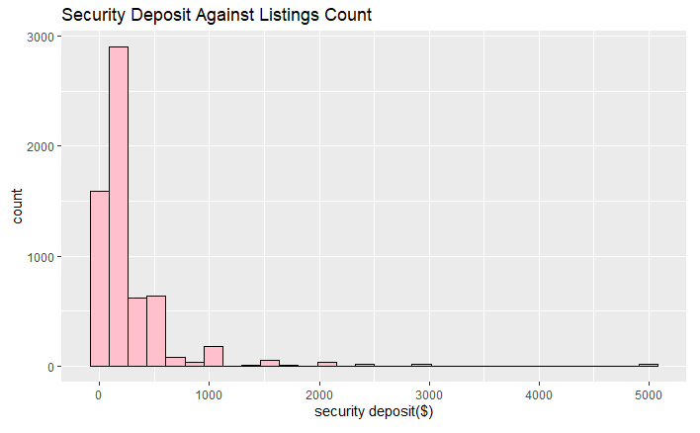
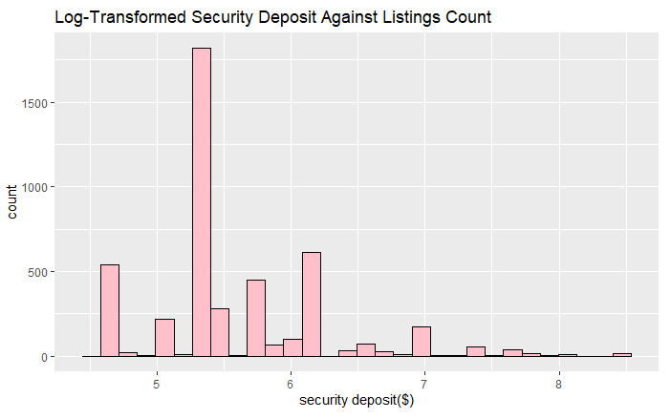
Log Transformation - Price and Security Deposit

Slide 6
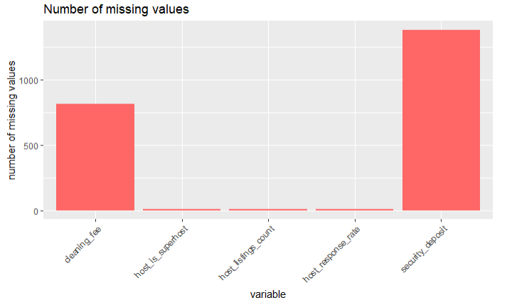
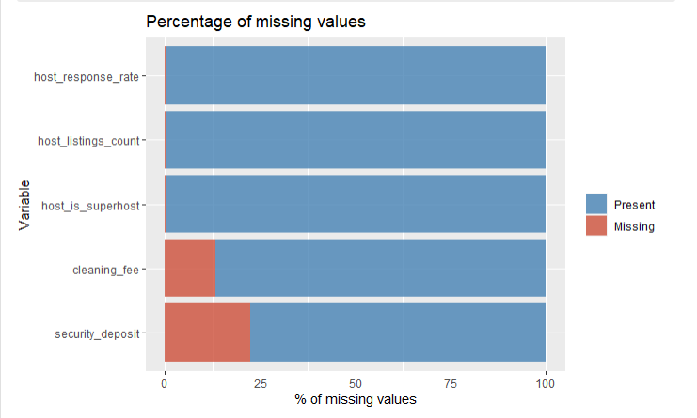
Treating Missing Values

Slide 7
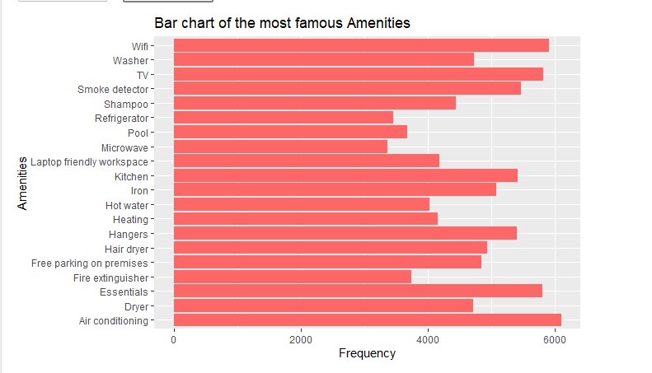
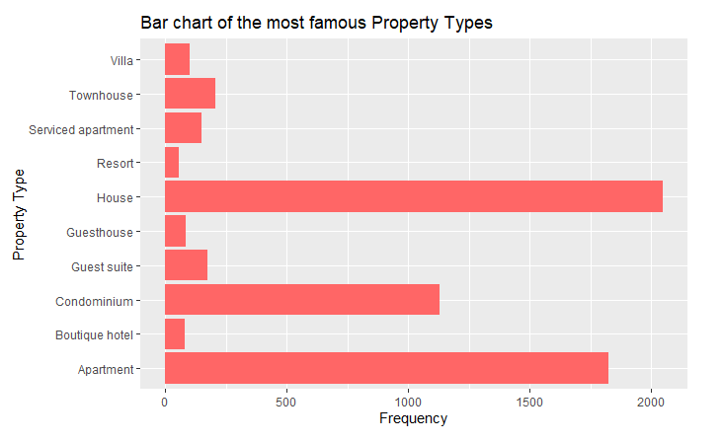
Treating Categorical Variables

Slide 8
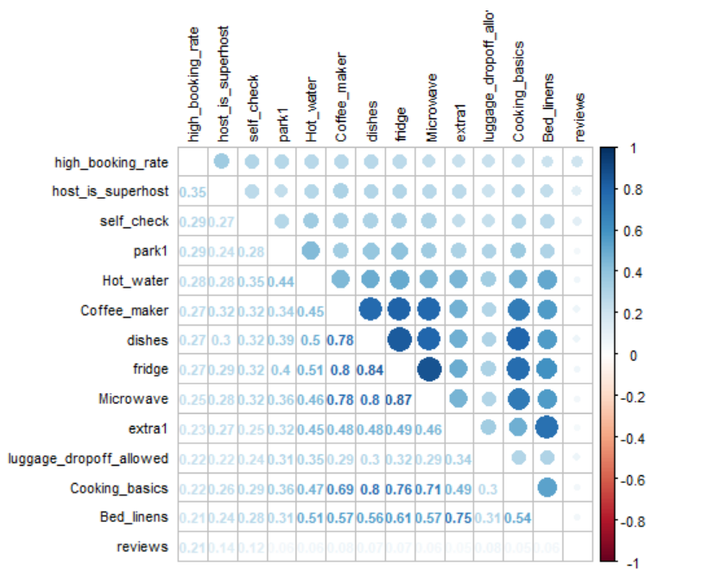
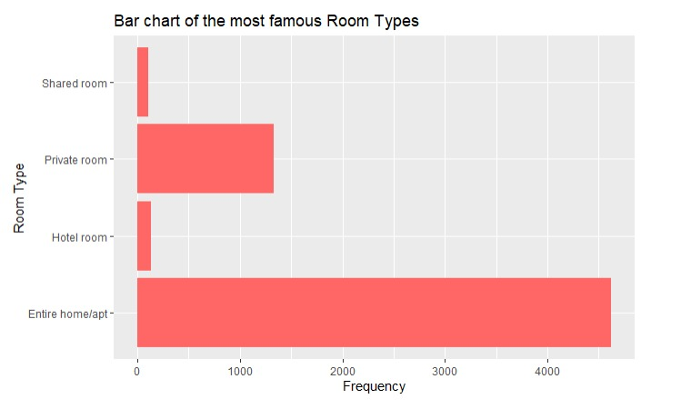
Results and Findings : Data Exploration
Notes:
We compared several correlations between high_booking_rate and numerical variables to find out important variables.

Slide 9
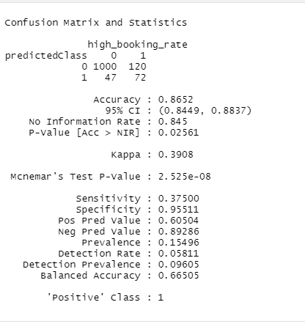
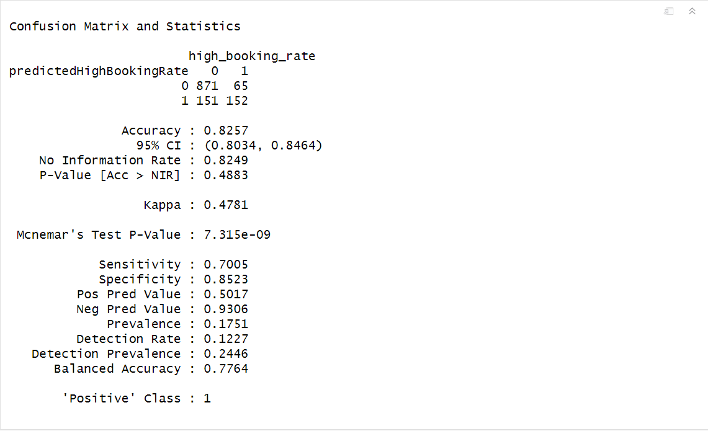
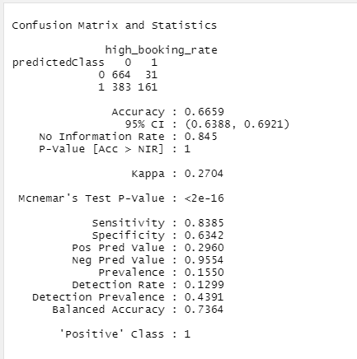
Model Performance : Logistic, LDA and QDA
Logistic
LDA
QDA

Slide 10

Conclusion
Data Cleaning is more important as compared to modelling.
Understanding variables is better than following the accuracy.
Some values were not easy to work with - Not all values could be replaced with a median.

Slide 11


